Slide 1
Empirical Study of Bug History in Projects
Presented by
Siddarth Udayakumar
Ishan Dwivedi
Keerthi Santhalingam

Slide 2
Introduction
Open Source Java Projects
> 1000 lines of code
Junit Test cases in the projects
Study on Bug History
How Junit tests allow for finding bugs
Internal testing Vs After Release support.
Notes:
How presentation will benefit audience: Adult learners are more interested in a subject if they know how or why it is important to them.
Presenter’s level of expertise in the subject: Briefly state your credentials in this area, or explain why participants should listen to you.

Slide 3
Research
Research on different type of bugs.
Bugs commonly encountered over course of software development.
Identified common bugs in projects we considered.
Some of the common bugs we identified include
Pointer and Memory related bugs.
Arithmetic bugs
Data Bugs
Synchronization bugs
Interfacing bugs.
Notes:
Lesson descriptions should be brief.

Slide 4
Memory and Pointer bugs
Memory Leaks
Resources once freed, being accessed to free them again.
Null dereferencing
Improper use of pointer aliasing.

Slide 5
Arithmetic bugs
Caused major or minor issues based on context.
Unexpected results and termination of program in cases.
More frequently occurring minor bug.
Easily resolved using basic unit testing.
Wrong operator precedence, Off by one error.

Slide 6
Data Bugs
Lot of bugs observed were data bugs.
Uninitialized variables.
Buffer overflow and underflow.
Buffer overflow causes security bugs in cases.
Synchronization bugs cause deadlocks in situations like multi threads.
Depending on order of threads, common resources got locked out.

Slide 7
Interfacing Bugs & Miscellaneous
Incorrect usage of APIs
Wrong implementation of certain protocols.
Incorrect assumptions of platform.
Apart from the bugs mentioned, Other common bugs we identified include
Performance bugs
Resource bugs.
UI Bugs.
Developer induced changes.

Slide 8
Projects Chosen for Research
Based on the various projects we went through, we chose the following projects based on the immediate requirements discussed in the introduction and also based on how proper the bug reports associated with each project was maintained.
Eclipse JDT Core
Apache Tomcat 8
Apache Cassandra
Apache Commons IO
Apache Phoenix
Apache Zookeper
Apache HBASE
Apache Knox
Apache Tajo
Notes:
Example objectives
At the end of this lesson, you will be able to:
Save files to the team Web server.
Move files to different locations on the team Web server.
Share files on the team Web server.

Slide 9
Parsing Through Project Repos
Parsed through Project Repos to check if project has suitable Junit test cases.
Created a corpus that can be used to ascertain any commits or test cases within the code.
Performed using Apache Commons IO in combination with Apache Lucene libraries.
Apache Lucene is full featured text search engine library.

Slide 10
Parsing XML list of Bug reports
We use only fixed bugs from the bug reports.
List of fixed bugs obtained from the bug tracker in an XML format.
The XML file is parsed for specific tags such as description, Bug ID and any Junit tests associated with it.
Description is obtained because it may provide extra information about the bug.
The obtained information has been stored in spreadsheets.

Slide 11
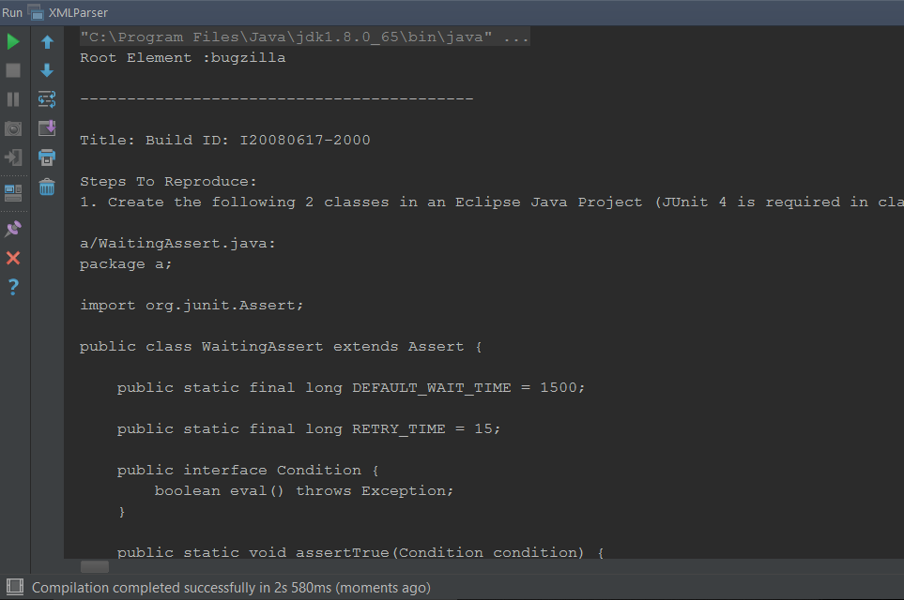
XML Parser output

Slide 12
Obtaining Junit Test cases
Created time overhead for reports.
Lack of proper documentation in certain cases.
So far, identified manually from reports.
Plan to implement new method along with JIRA API to automate search for Junit Tests.

Slide 13
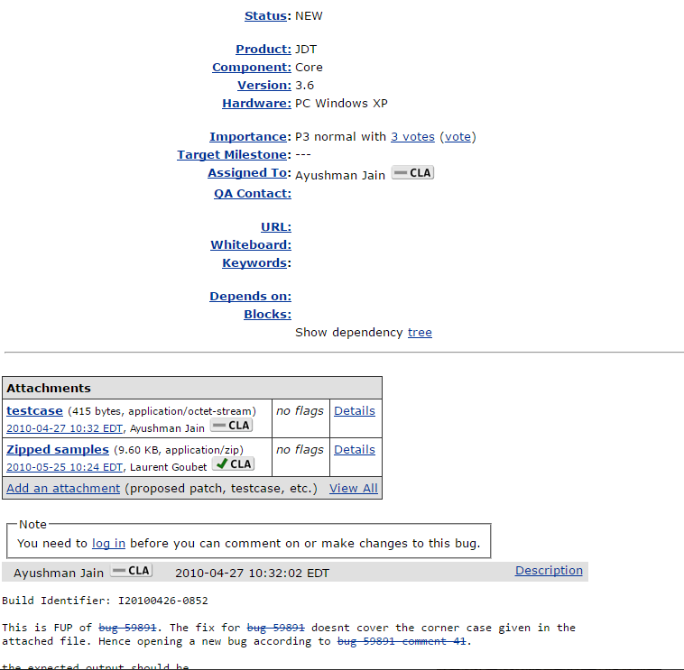
Junit test cases in bug reports

Slide 14
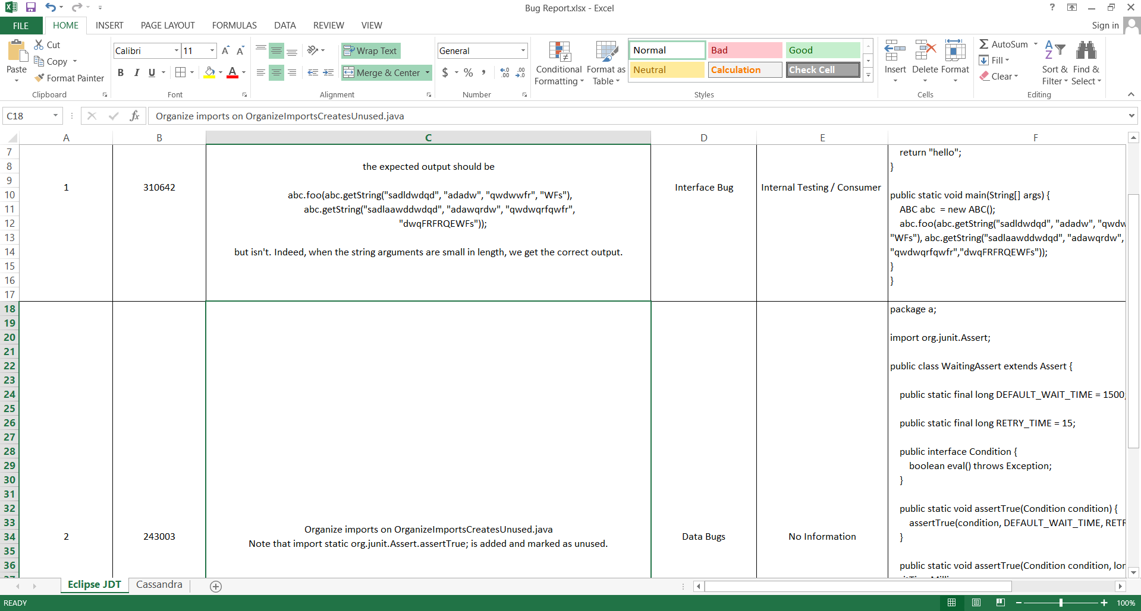
Our Data

Slide 15
Problems Encountered
Finding the right project. Changed projects midway.
Getting Junit test cases.
Manual work in spite of available data. Accurate results but, at cost of time.
Not enough information present on reports to identify bug or when It was reported.
Study bug report completely to ID bug and find initial report details.

Slide 16
Future Plan
Get Bug reports and other information from remaining projects.
Try addition of NLTK to automate type of bugs.
Compare and consolidate findings of information obtained from each project.
Complete final report and infer when bugs are found during the course of software development.

Slide 17
References
Zhong, Hao, and Zhendong Su. "An empirical study on real bug fixes."Proceedings of the 37th International Conference on Software Engineering-Volume 1. IEEE Press, 2015.
Mockus, Audris, Roy T. Fielding, and James D. Herbsleb. "Two case studies of open source software development: Apache and Mozilla." ACM Transactions on Software Engineering and Methodology (TOSEM) 11.3 (2002): 309-346.
Apache Common and Lucene libraries.
Wikipedia.

Slide 18
Thank You!

